Slide 1






EF Advanced Querying
Performance Optimizations
Advanced
Querying
SoftUni Team
Technical Trainers
Software University
http://softuni.bg

Slide 2


Table of Contents
Native SQL Queries
Object State
Batch Operations
Stored Procedures
Concurrency
Cascade Operations

Slide 3
Questions
sli.do #CSharpDB

Slide 4
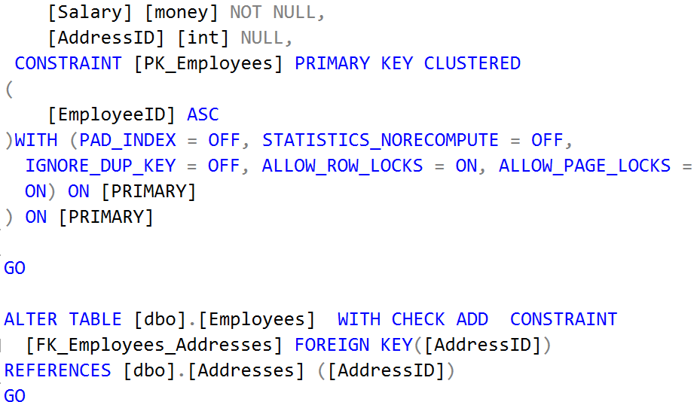
Executing Native SQL Queries
Parameterless and Parameterized

Slide 5
Executing Native SQL Queries
Executing a native SQL query in EF Core directly:
Limitations:
JOIN statements don’t get mapped to the entity class
Required columns must always be selected
Target table must be the same as the DbSet
var query = "SELECT * FROM Employees";
var employees = db.Employees
.FromSql(query)
.ToArray();

Slide 6
Native SQL Queries with Parameters
Native SQL queries can also be parameterized:
var context = new SoftUniDbContext();
string nativeSQLQuery =
"SELECT FirstName, LastName, JobTitle" +
"FROM dbo.Employees WHERE JobTitle = {0}";
var employees = context.Employees.FromSql(
nativeSQLQuery, "Marketing Specialist");
foreach (var employee in employees)
{
Console.WriteLine(employee);
}
Parameter placeholder
Parameter value

Slide 7
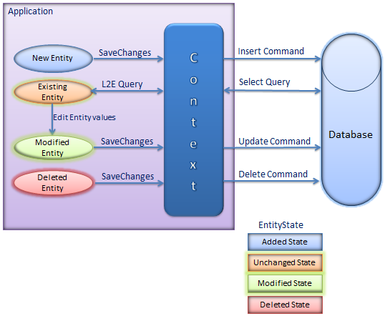
Object State Tracking

Slide 8
Attaching and Detaching Objects
In Entity Framework, objects can be:
Attached to the object context (tracked object)
Detached from an object context (untracked object)
Attached objects are tracked and managed by the DbContext
SaveChanges() persists all changes in DB
Detached objects are not referenced by the DbContext
Behave like a normal objects, which are not related to EF

Slide 9
Attaching Detached Objects
When a query is executed inside an DbContext, the returned objects are automatically attached to it
When a context is destroyed, all objects in it are automatically detached
E.g. in Web applications between requests
You might later on attach objects that have been previously detached to a new context

Slide 10
Detaching Objects
When is an object detached?
When we get the object from a DbContext and then Dispose it
Manually: by setting the EntryState to Detached
Employee GetEmployeeById(int id)
{
using (var SoftUniDbContext = new SoftUniDbContext())
{
return SoftUniDbContext.Employees
.First(p => p.EmployeeID == id);
}
}
Returned employee is detached

Slide 11
Attaching Objects
When we want to update a detached object we need to reattach it and then update it: change to Attached state
void UpdateName(Employee employee, string newName)
{
using (var SoftUniDbContext = new SoftUniDbContext())
{
var entry = SoftUniDbContext.Entry(employee);
entry.State = EntityState.Added;
employee.FirstName = newName;
SoftUniDbContext.SaveChanges();
}
}

Slide 12
Stored Procedures

Slide 13
Executing a Stored Procedure
Stored Procedures can be executed via SQL
CREATE PROCEDURE UpdateAge @param int
AS
UPDATE Employees SET Age = Age + @param;
var ageParameter = new SqlParameter("@age", 5);
var query = "EXEC UpdateAge @age";
context.Database.ExecuteSqlCommand(query, ageParameter);
Notes:
More information on how tom make stored procedures for Insert, update and delete - https://msdn.microsoft.com/en-us/library/dn468673(v=vs.113).aspx

Slide 14
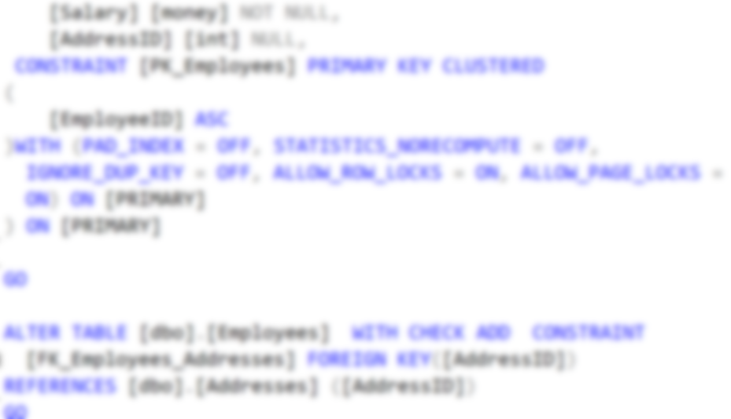
Bulk Operations
Update
Update
Batch
Query
Update
Update
Multiple Update and Delete in Single Query

Slide 15
EntityFramework-Plus
Entity Framework does not support bulk operations
Z.EntityFramework.Plus gives you the ability to perform bulk update/delete of entities
Install Z.EntityFramework.Plus.EFCore as a NuGet package
Install-Package Z.EntityFramework.Plus.EFCore
Notes:
https://weblogs.asp.net/pwelter34/entity-framework-batch-update-and-future-queries

Slide 16
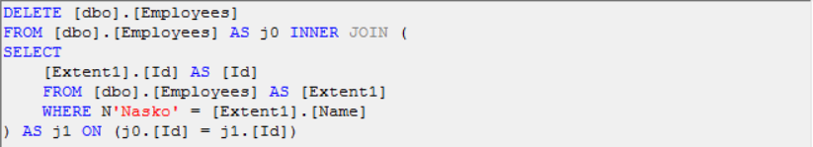
Bulk Delete
Delete all users where FirstName matches given string
context.Employees
.Where(u => u.FirstName == "Pesho")
.Delete();

Slide 17
Bulk Update: Syntax
Update all Employees with name “Nasko” to “Plamen”
Update all Employees’ age to 99 who have the name “Plamen”
context.Employees
.Where(t => t.Name == "Nasko")
.Update(u => new Employee() {Name = "Plamen"});
IQueryable<Employee> employees = context.Employees
.Where(employee => employee.Name == "Plamen");
employees.Update(employee => new Employee() { Age = 99 });

Slide 18
Types of Loading
Lazy, Eager and Explicit Loading

Slide 19
Explicit Loading
Explicit loading loads all records when they’re needed
Performed with the Collection().Load() method
var employee = context.Employees.First();
context.Entry(employee)
.Reference(e => e.Department)
.Load();
context.Entry(employee)
.Collection(e => e.EmployeeProjects)
.Load();

Slide 20
Eager Loading
Eager loading loads all related records of an entity at once
Performed with the Include method
context.Towns.Include("Employees");
context.Towns.Include(town => town.Employees);
context.Employees
.Include(employee => employee.Address)
.ThenInclude(address => address.Town)

Slide 21

Lazy Loading
Lazy Loading delays loading of data until it is used
EF Core enables lazy-loading for any navigation property that can be overridden
Offers better performance in certain cases
Less RAM usage
Smaller result sets returned

Slide 22
Lazy Loading Proxies
Install Lazy Loading Proxies
Enable the package
Install-Package Microsoft.EntityFrameworkCore.Proxies
void OnConfiguring (DbContextOptionsBuilder options)
{
options
.UseLazyLoadingProxies()
.UseSqlServer(myConnectionString);
}

Slide 23




Concurrency Checks

Slide 24
Optimistic Concurrency Control in EF
EF Core runs in optimistic concurrency mode (no locking)
By default the conflict resolution strategy in EF is "last one wins"
The last change overwrites all previous concurrent changes
Enabling "first wins" strategy for certain property in EF:
[ConcurrencyCheck]

Slide 25
Last One Wins – Example
var contextFirst = new SoftUniDbContext();
var lastProjectFirstUser = contextFirst.Projects.First();
lastProjectFirstUser.Name = "Changed by the First User";
// The second user changes the same record
var contextSecondUser = new SoftUniDbContext();
var lastProjectSecond = contextSecondUser.Projects.First();
lastProjectSecond.Name = "Changed by the Second User";
// Conflicting changes: last wins
contextFirst.SaveChanges();
contextSecondUser.SaveChanges();
Second user wins

Slide 26
First One Wins – Example
var context = new SoftUniDbContext();
var lastTownFirstUser = contextFirst.Towns.First();
lastTownFirstUser.Name = "First User";
var contextSecondUser = new SoftUniDbContext();
var lastTownSecondUser = contextSecondUser.Towns.First();
lastTownSecondUser.Name = "Second User";
context.SaveChanges();
contextSecondUser.SaveChanges();
Changes get saved
DbUpdateConcurrencyException

Slide 27
Cascade Operations
Client
Order
OrderProducts
Deleting Related Entities

Slide 28
Cascade Delete Scenarios
Required FK with cascade delete set to true, deletes everything related to the deleted property
Required FK with cascade delete set to false, throws exception (it cannot leave the navigational property with no value)
Optional FK with cascade delete set to true, deletes everything related to the deleted property.
Optional FK with cascade delete set to false, sets the value of the FK to NULL

Slide 29
Cascade Delete with Fluent API
Using OnDelete with DeleteBehavior Enumeration:
DeleteBehavior.Cascade
Deletes related entities (default for required FK)
DeleteBehavior.Restrict
Throws exception on delete
DeleteBehavior.ClientSetNull
Default behavior for optional FK (does not affect database)
DeleteBehavior.SetNull
Sets the property to null (affects database)

Slide 30
Cascade Delete with Fluent API (2)
Cascade delete syntax:
modelBuilder.Entity<User>()
.HasMany(u => u.Replies)
.WithOne(a => a.Author)
.OnDelete(DeleteBehavior.Restrict);
modelBuilder.Entity<User>()
.HasMany(u => u.Replies)
.WithOne(a => a.Author)
.OnDelete(DeleteBehavior.Cascade);

Slide 31
Summary
Databases can be accessed directly with SQL queries from C# code
EF keeps track of the model state
Entity Framework-Plus lets you bundle update and delete operations
With multiple users, concurrency of operations must be observed
Cascade delete is on by default

Slide 32







EF Advanced Querying
https://softuni.bg/courses/databases-basics-ms-sql-server

Slide 33






SoftUni Diamond Partners

Slide 34






SoftUni Diamond Partners

Slide 35
License
This course (slides, examples, demos, videos, homework, etc.) is licensed under the "Creative Commons Attribution-NonCommercial-ShareAlike 4.0 International" license
Attribution: this work may contain portions from
"Databases" course by Telerik Academy under CC-BY-NC-SA license

Slide 36





Trainings @ Software University (SoftUni)
Software University – High-Quality Education, Profession and Job for Software Developers
softuni.bg
Software University Foundation
http://softuni.foundation/
Software University @ Facebook
facebook.com/SoftwareUniversity
Software University Forums
forum.softuni.bg

